Slide 1
BMT in Hodgkin
Mehrdad payandeh ,MD
KUMS,2020/sep/17

Slide 2
Indication for AHSCT in HD

Slide 3
AHSCT in HD

Slide 4
Pet Scan

Slide 5
Indication for Allogenic HSCT in HD

Slide 6
Mobilizations

Slide 7
Conditioning regimen

Slide 8
Conditioning regimen

Slide 9
Haploidentical transplant

Slide 10
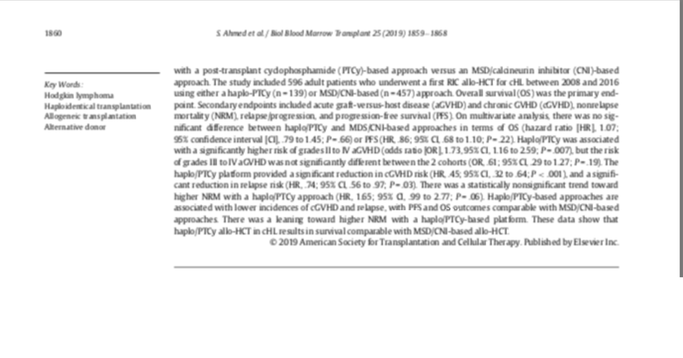
Haploidentical transplant

Slide 11
Umbilical cord transplant

Slide 12
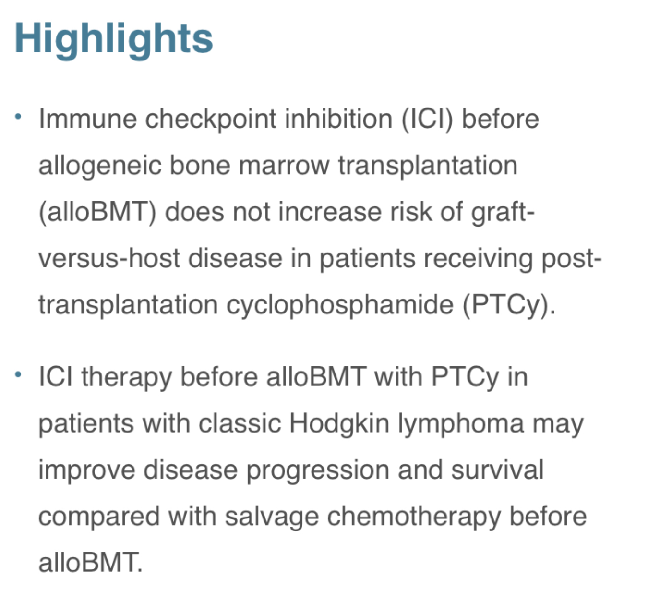
Immune Check Point Inhibitors

Slide 13
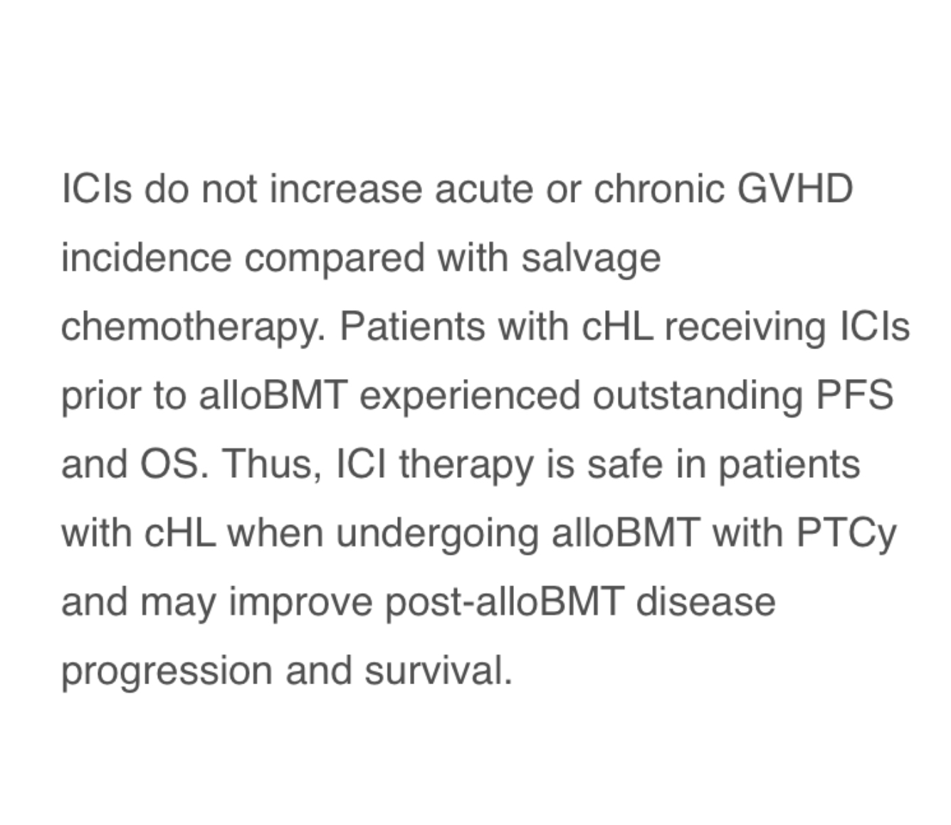
Immune Check Point Inhibitors

Slide 14
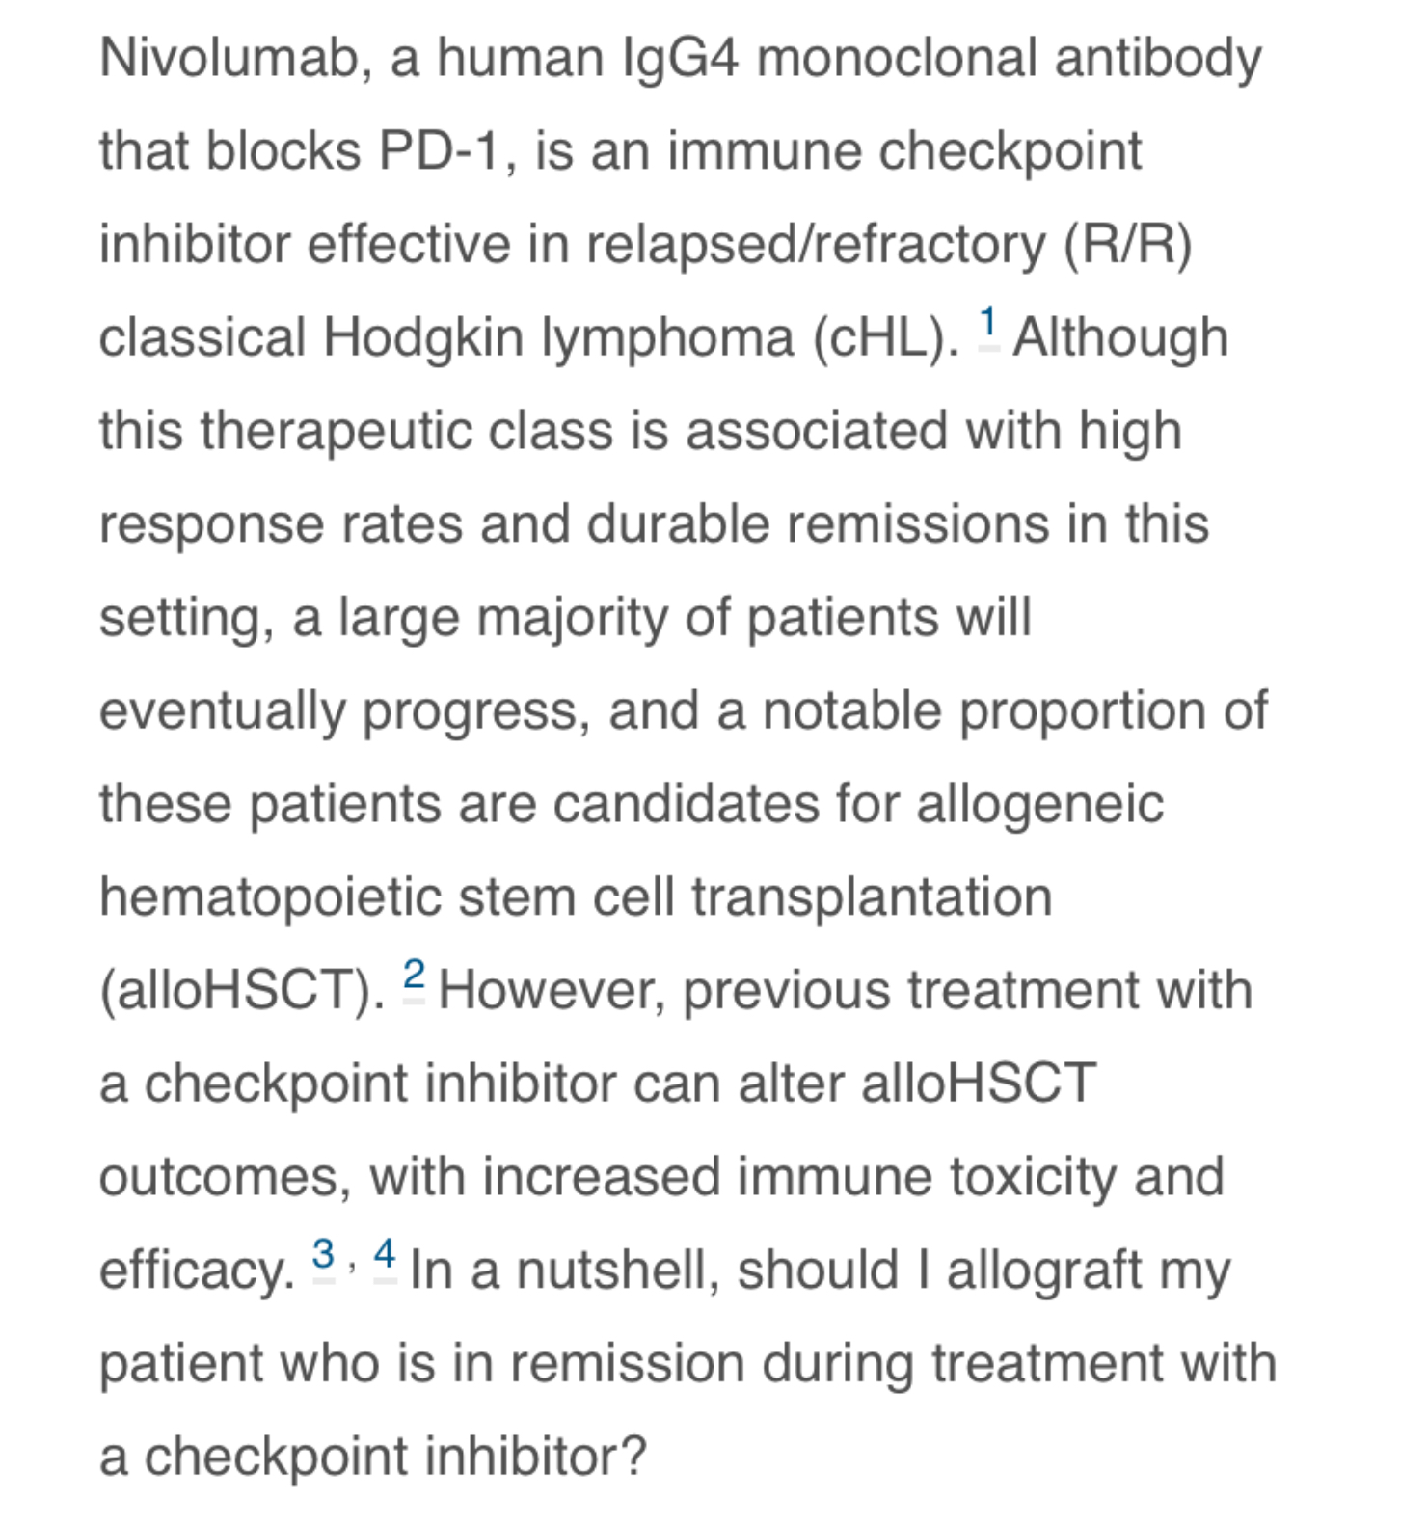
Immune Check Point Inhibitors

Slide 15
Brentuximab vendotin

Slide 16
Brentuximab vendotin

Slide 17
Treatment after autologous bmt

Slide 18
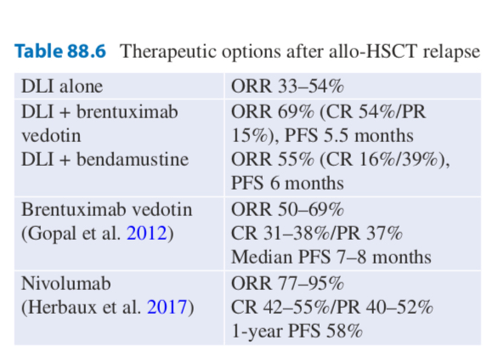
Treatment after allogenous bmt

